Slide 1
Wholesale Customer Segmentation
Andrew J. Otis

Slide 2
Task to Accomplish
To identify and describe potential customer segments hidden within the data…

Slide 3
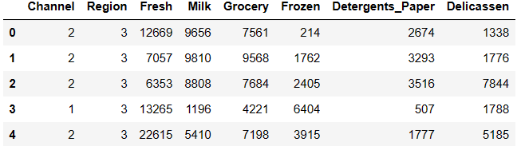
The Data
Encoded ‘Region’ Column
1 = Lisbon
2 = Oporto
3 = Other Region
Encoded ‘Channel’ Column
1 = HORECA
2 = Other Region
… based on annual spending on diverse product categories (e.g. Grocery, Frozen, etc.) of various business types (i.e. Hotel, Restaurant, and Café grouped as ‘HORECA’ and ‘Other’) located in various regions.
Table 1: Data frame of the dataset scraped from the UCI Machine Learning Repository
Notes:
----Description of Variables----
- REGION: customer Region (Nominal)
- CHANNEL: "Horeca" or "Retail" (Nominal)
- FRESH: annual spending on fresh products (Continuous)
- MILK: annual spending on milk products (Continuous)
- GROCERY: annual spending on grocery products (Continuous)
- FROZEN: annual spending on frozen products (Continuous)
- DETERGENTS_PAPER: annual spending on detergents and paper products (Continuous)
- DELICATESSEN: annual spending on and delicatessen products (Continuous)
----Identifying Encoded Variables----
# For the Region Column
# 1 = Lisbon
# 2 = Oporto
# 3 = Other Region
# For the Channel Column
# 1 = Horeca
# 2 = Retailer
----The Data Encoded----
Unique Channels: [2, 1]
Unique Regions: [3, 1, 2]

Slide 4
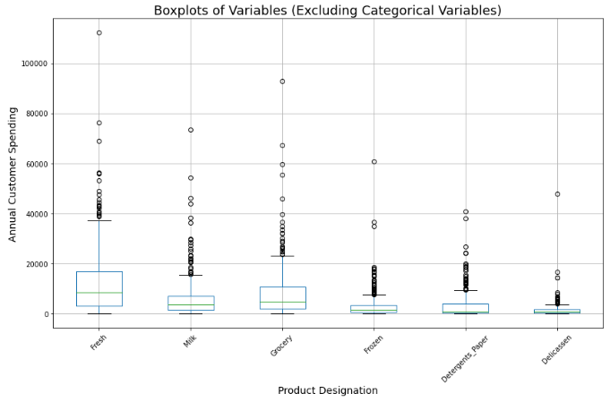
Summary Stats (boxplot)
Figure 1: The plot visualizes the summary statistics of the data (e.g. range, variance, etc.)
Notes:
-----Summary Stats (numeric)----
Channel Region Fresh Milk Grocery Frozen Detergents_Paper Delicassen
mean 1.322727 2.543182 12000.297727 5796.265909 7951.277273 3071.931818 2881.493182 1524.870455
std 0.468052 0.774272 12647.328865 7380.377175 9503.162829 4854.673333 4767.854448 2820.105937
min 1.000000 1.000000 3.000000 55.000000 3.000000 25.000000 3.000000 3.000000

Slide 5
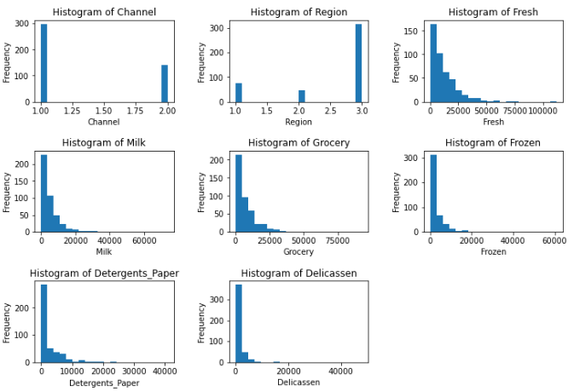
Feature Distributions
Figure 2: Distribution of all features present, respectively.
Notes:
The distributions of the data all have been skewed to the right in common, excluding the categorical features. Remember, not looking for a normal distribution (i.e. data assumption), just exploring shape of the data

Slide 6
Principal Component Analysis
The purpose is to reduce dimensions of the data to the most important features (i.e. principal components) to be inputs for our clustering models.
For models that require specifying clusters manually(e.g. K-means)
A model with 1 categorical & 2 numeric features :
The candidate features for clustering are the product categories 'Grocery' and 'Frozen’
A model with 1 categorical & 3 numeric features:
The candidate features for clustering are the product categories 'Grocery’, 'Frozen’, and ‘Fresh’

Slide 7
Clustering Algorithms and Strategy
K-Means Clustering
Hierarchal Clustering (agglomerative)
Unlike supervised ML models, clustering only attempts to identify patterns in data, and thus has no “target” variable.
Pick a Clustering Algorithm
Fit the model to identify clusters
Plot clusters against un-scaled data
Create copy of the original data frame for current model
Scale data appropriately
Identify and describe customer segments

Slide 8
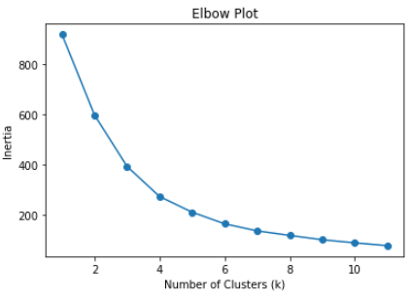
Elbow Plot for K-Means
Figure 3: Remember, k-means requires one to explicitly specify the desired number of clusters. In this case, 4 clusters appears to be the optimal number of clusters.

Slide 9
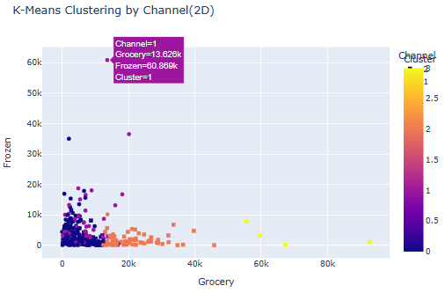
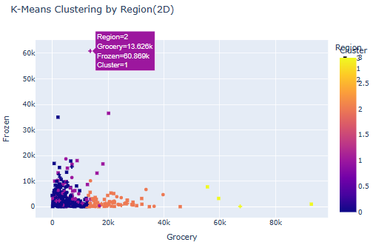
Visualize the K-means Clusters in 2D
Notice, analyzing the graphs in tandem allows us to compare regions and channels simultaneously
Figure 4: Clusters visualized by Channel and Region, for 2D scatterplot representation, respectively.
Notes:
Don’t discuss segments here, only emphasize outliers and their importance and
Mention that the clusters are color coded, with symbols representing either the ‘Channel’ or ‘Region’ column cannot use them simultaneously

Slide 10
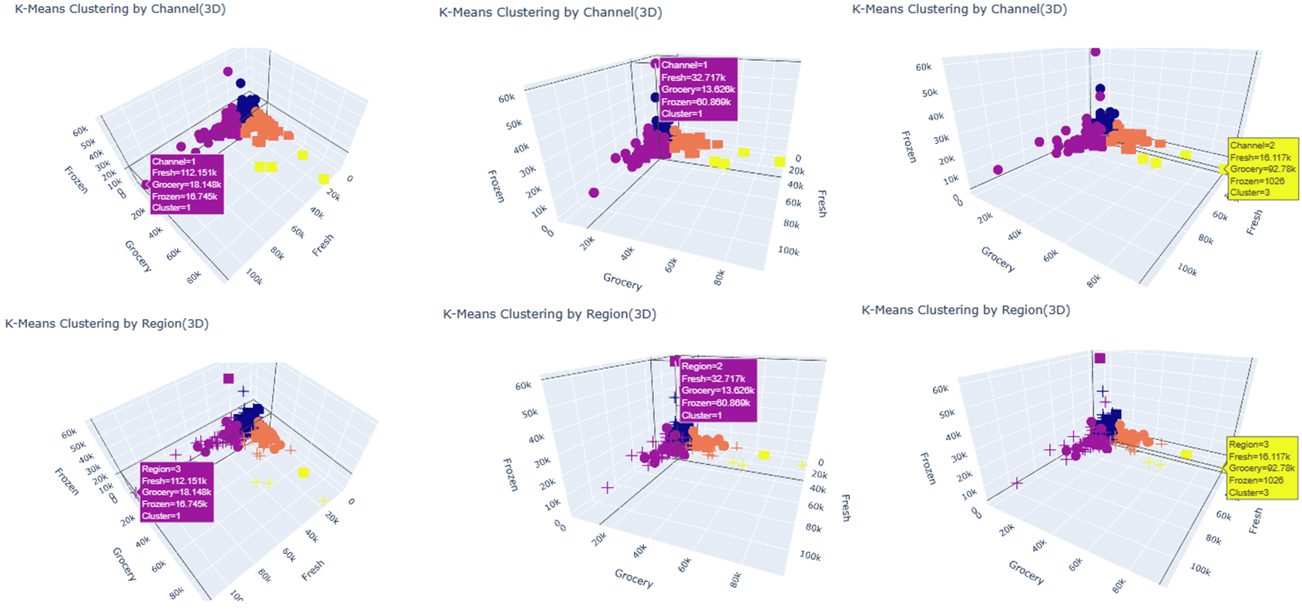
Visualize the K-means Clusters in 3D
Figure 5: Clusters visualized by Channel and Region, for 3D scatterplot representation, respectively.
Notes:
After explaining why the plots are arranged as they are, move on to next slide to discuss actual value comparisons

Slide 11
Customer Segmentation from K-Means Clustering
Segment 1
A HORECA customer in region “Oporto”, from cluster 1 that has most of the annual spending in the ‘Frozen’ category
Segment 2
A HORECA customer in region “Other”, from cluster 1 that has most of the annual spending in the ‘Fresh’ category
Segment 3
A non-HORECA customer in region “Other”, from cluster 3 that has most of the annual spending in the ‘Grocery’ category
Notes:
----Segment 1 Comments----
- The business could be something like an ice cream shop, where a majority of products would likely be labeled under that ‘Frozen’ product designation.
----Segment 2 Comments----
- The business could be something like a farmers' market, where most of the products were something sourced recently. Unlike grocery stores or other HORECA businesses, Farmers markets typically occur only once or twice a week. These markets are typically advertised to have the freshest items for sale.
----Segment 3 Comments----
The business is probably an actual grocery store (e.g. Costco, King Soopers, etc.) or places like gas station convenience stores.

Slide 12
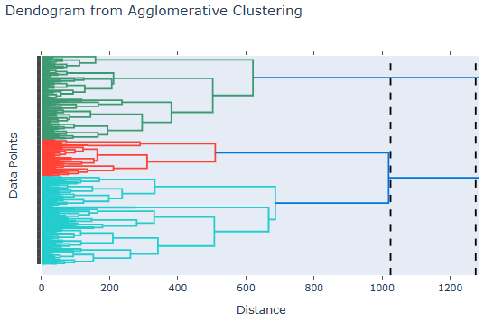
Dendrogram from Agglomerative Clustering
Figure 6: Algorithm automatically clusters the data, no need to explicitly specify the desired number of clusters. In this case, the algorithm determined 2 clusters to be the ideal number. This is supported by the only cluster labels resulting being “0” & “1”
Notes:
#Important Note:
# To determine how many clusters the algorithm though appropriate given the
# simply draw 2 lines where the distance is the greatest an neither line
# intersects more than 1 cluster. The number of dendrogram branches within
# those specific boundaries is the number of clusters chosen by the
# agglomerative algorithm.

Slide 13
Customer Segmentation from Hierarchal Clustering
Segment 1
A HORECA customer in region “Other”, from cluster 0 that has most of the annual spending in the ‘Fresh’ category
Segment 2
A HORECA customer in region “Oporto”, from cluster 0 that has most of the annual spending in the ‘Frozen’ category
Segment 3
A non-HORECA customer in region “Other”, from cluster 1 that has most of the annual spending in the ‘Grocery’ category
Notes:
----Segment 1 Comments----
This could likely be a HORECA business that specializes in Fresh products, possibly a farmers market
----Segment 2 Comments----
This could likely be a HORECA business that specializes in Frozen products, possibly an ice cream bar
----Segment 3 Comments----
A non-HORECA business, likely an actual grocery store (e.g. Costco, King Soopers, etc.)

Slide 14
Model Comparisons
Based on the task at hand, I believe the K-means clustering addresses those needs best.
The issue with only having 2 clusters (i.e. Hierarchal Clustering results) is there’s too much overlapping between the 2 clusters identified.
Additionally, there are data points so different from one another that intuitively one would assume they’d be in different clusters.

Slide 15
References
Cardoso, M. (2014). Wholesale customers Data Set. Retrieved from UCI Machine Learning Repository.
Dalton, D. (2023). Data Science Captsone [COMP 4449]. University of Denver.

